Slide 1

summary of MTG Contest #1
MTG_DREAMSKEYCX 2026.1.6

Slide 2
Why Hold This Competition
Everyone wants to have fun and needs such a platform
The vanilla levels have been learned, and the balance of season strategies is unsatisfactory
The author has not updated for a long time
Results and reflections from debates in other communities

Slide 3
Contest Content
With significant reference to official competitions

Slide 4
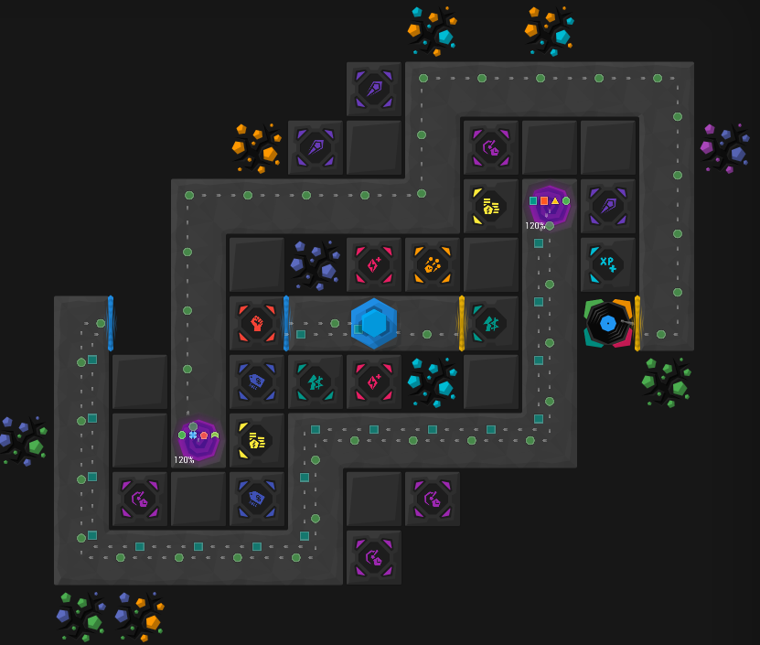
Contest Content
Level: 4.3
Judged by Score
Must play in Normal Mode
Allowed towers: Antiair, Splash, Blast, Multishot, Tesla, Missile, Crusher
Only 30 ability energy cost points
Banned modifiers: Bounty
No other restrictions

Slide 5
Ideas and Solutions
Multishot's Level 10 skill: Coin Platform to boost economy
Direct Overload in the early to mid-game; Mining Modifiers to increase mining scores
Crusher and Tesla for enemy output in the mid-game; Antiair for air target output
Blast provides the only control
Coordination strategy between Splash and Magnet to farm MDPS
Use low-cost damage abilities such as Lightning Ball and Fireball

Slide 6
Ranking Results
OB experts are too strong!

Slide 7
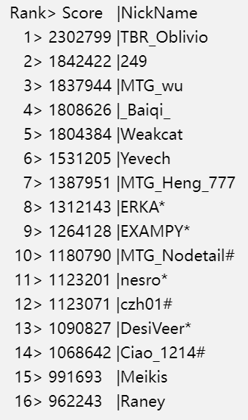
Top 3 in Regular & BEGINNERS
Regular#1 TBR_Oblivio 2302799
Regular#2 249 1842422
Regular#3 MTG_wu 1837944
Beginner#1 MTG_Nodetail 1180790
Beginner#2 czh01 1123071
Beginner#3 Ciao_1214 1068642

Slide 8
Guaranteed Reward Recipients
Guaranteed rewards for scores above 1.2 million
Recipients: Baiqi, Yevech, Weakcat, Heng

Slide 9
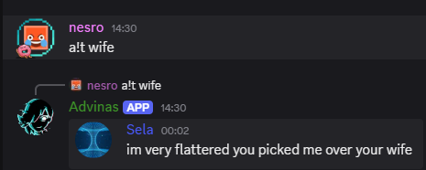
Discord Players!
Moving it over to Discord was just one of Saki’s initial ideas
But unexpectedly, it drew quite a lot of attention from many Discord users
So a dedicated server was set up, and we’re preparing to develop tools to let Discord players participate—
which is also why this video was made
Thanks to ERKA(Sela), Nesro, EXAMPY, DesiVeer!

Slide 10
Why use this icon?
Thanks to ERKA (Sela) for submitting an MTG Contest icon!
The “C” represents the Contest element, while the background features elements from Infinitode
The green symbolizes the vitality and energy of the competition
Nesro made a Venom FS version—looks like he really likes it.

Slide 11
Replay Demonstration Session
Replay Showcases

Slide 12
Replay Showcases
Demonstrate replays of the top 3 in the Regular Track
Demonstrate the replay of the 1st place in the Novice Track
Other replays available for download on GitHub: mtgpublic/mtgcontest

Slide 13
Thank you for watching~
Meow meow meow~

